Slide 1

Mental health prediction app
Author: Rohini Ghosh

Slide 2
Table of Contents
Acknowledgement
About Me
My Internship Journey with Clevered
About App
How Do I use the App?
Toolkit Walkthrough
Contact Person

Slide 3

Acknowledgement
I would like to thank my mentors and the entire team of Clevered who helped me complete this project and execute my ideas successfully.
I was frequently reached out on emails so as to fix the errors in my application . These follow ups ensured the smooth running of my project. The internship team of Clevered helped me in every possible way and explained all concepts in so much detail! I got to learn something new in every session with hands-on experience for the first time . This internship gave me an exact picture of how it is like to work with industry experts with even the most minute details in mind.
Clevered has helped me immensely to hone my presentation and communication skills and become a confident speaker. It has taught me the ways of effective professional communication and how to present my work in the best possible way . Truly, I could have never asked for a better internship!

Slide 4
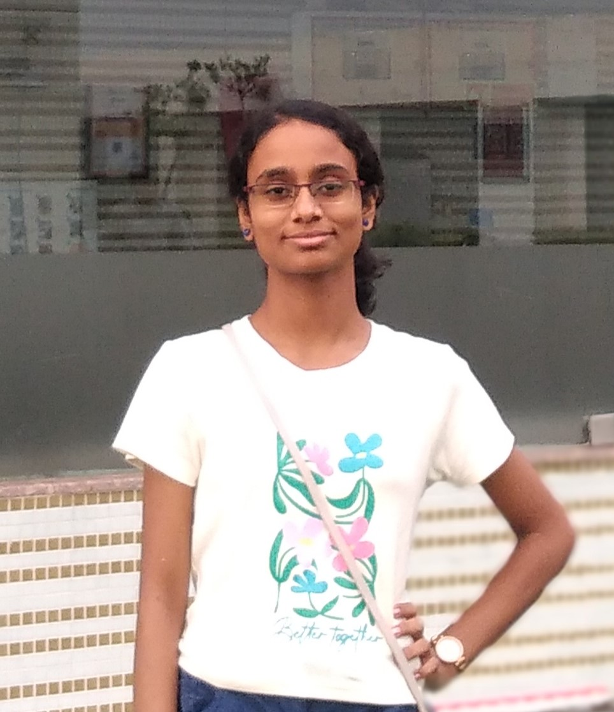
My Photograph
Student’s Introduction
I’m Rohini , a coding enthusiast, currently in grade XII .Python is a part of my school curriculum , and I had AI as my sixth subject in grade IX. However, I was keen to learn more , and it influenced me to broaden my knowledge about AI and start working on a project that would be socially impactful with hands-on experience in different domains of AI. I have a passion for innovating and implementing ideas of my own and developing something unique ! I’m truly excited about what AI has in store for us. The power of AI to change our future for the better is what deeply interests me in this field , and I’m always eager to discover the undiscovered. AI can do almost anything and much more than one can even think of . Designing efficient algorithms is what I enjoy. The first thing that came to my mind was an app that would be able to accurately track a student’s mental health status and recommend on that basis of input data if he/she needs any specialized treatment or counselling.

Slide 5
About My Internship Journey with Clevered.
My journey with Clevered so far has been a truly enriching one . It gave me a detailed picture of coding with keen emphasis on different AI domains like NLP , Machine Learning , CV etc. This internship not only paid keen attention to coding skills but also enhanced my soft skills including presentation , communication , time management , problem solving , and work experience. At the same time, I found this internship a little challenging . I and my mentors had to do repeated follow-ups to correct the blocks of incorrect code and come up with an appropriate solution to the same. The weekly home assignments ensured that I didn’t lose touch with the subject and constantly kept upgrading my skills as a young coder. I have never worked on any AI project before , and found this internship to be a highly engaging one . It taught me how to strike a perfect balance between school studies and curriculum outside school. Admittedly, it’s well worth the effort.

Slide 6
About App
App’s Main Menu
Prediction of depression
Prediction of anxiety
Prediction of panic attack
Seeking specialized treatment
User Interface
Important conclusions drawn
Data visualization /analysis
Graphical representation
App’s Introduction
This mental health prediction app will predict on the basis of an imported dataset if a college student is suffering from depression/anxiety/panic attack and needs any specialist treatment for the same . A machine learning model has been trained to take the final decision using a decision tree. Some selected graphs are also plotted for visual representation and the primary inferences are shown in the User Interface.

Slide 7
How to use the App?

Slide 8
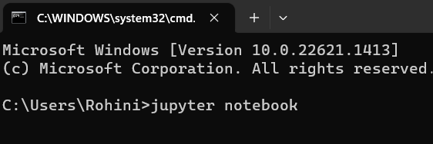
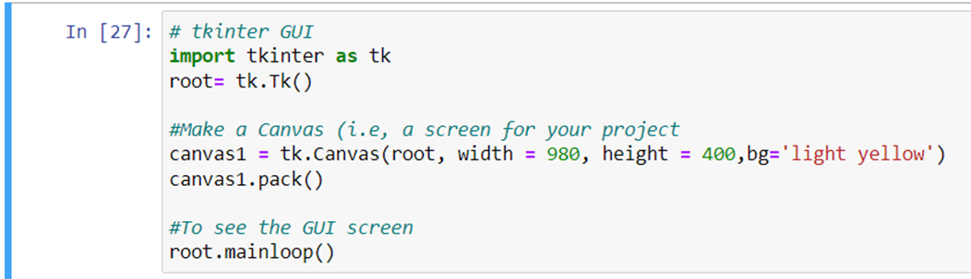
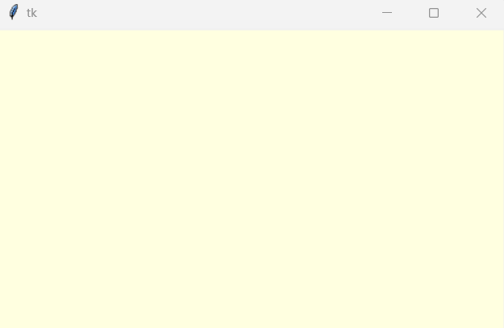
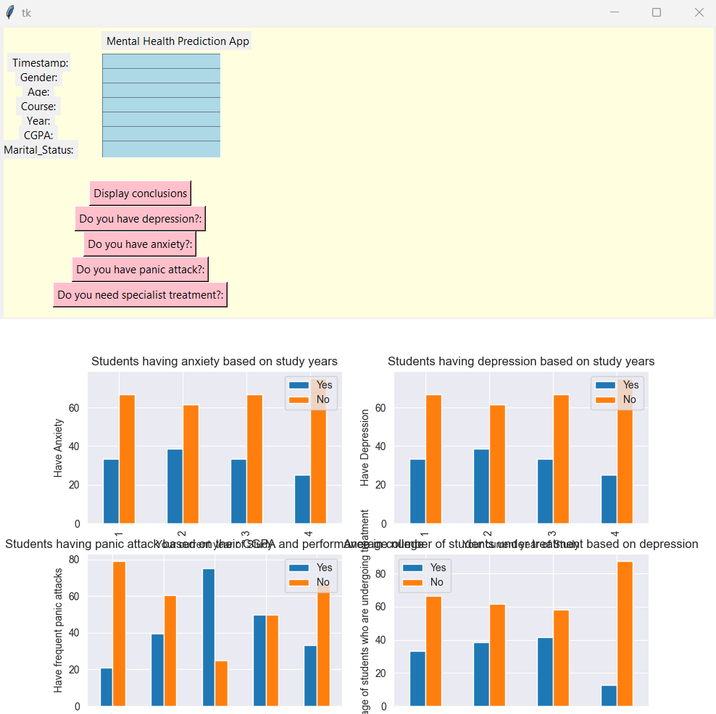
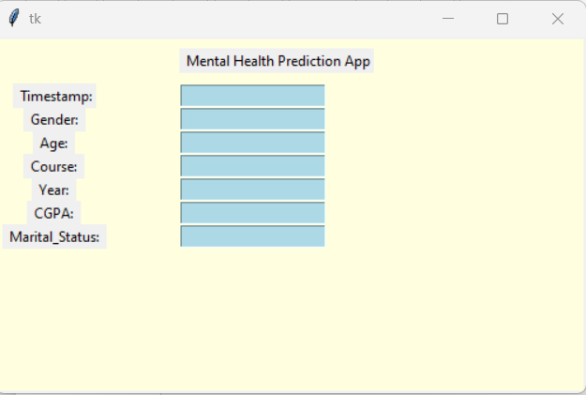
Go to CMD and type ‘jupyter notebook’
App User Interface
Execute the code to direct at first UI
Blank UI
Third UI
For each of the seven labels , the entries are to be made in the entry boxes(highlighted in blue).
Entry Boxes/Data fields
Labels

Slide 9
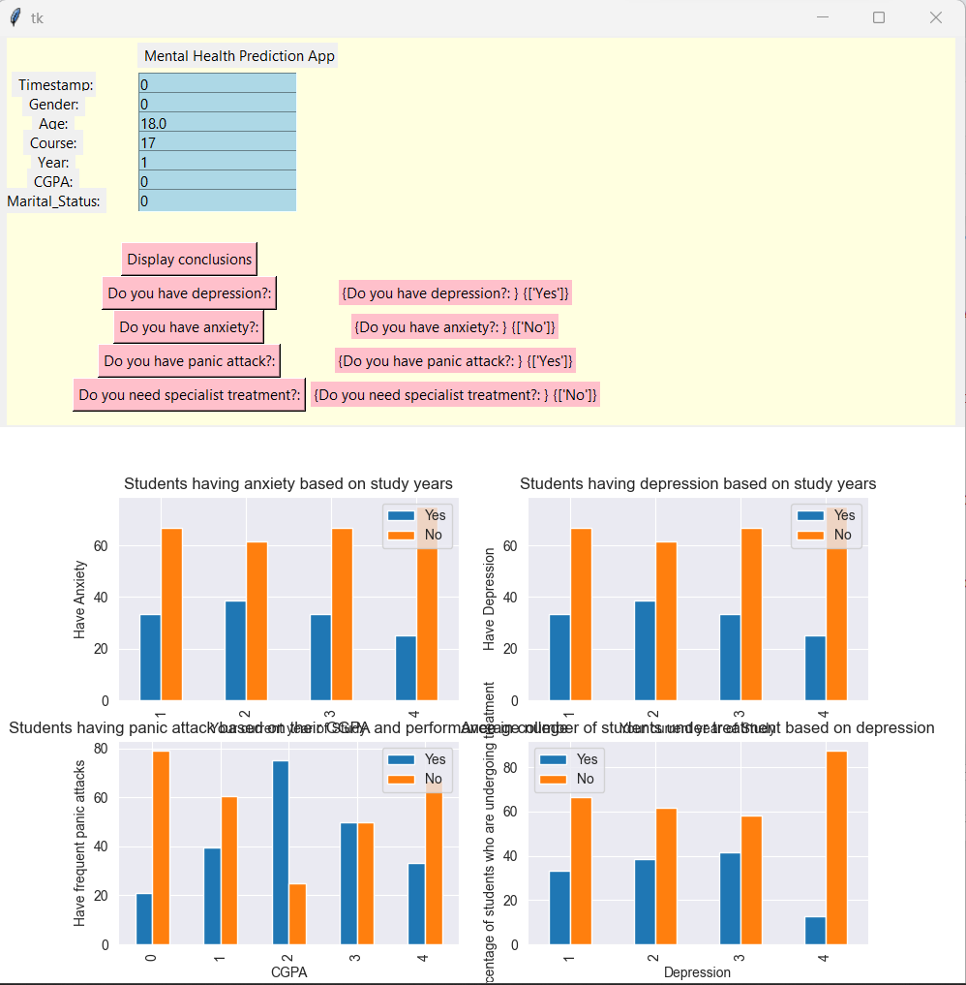
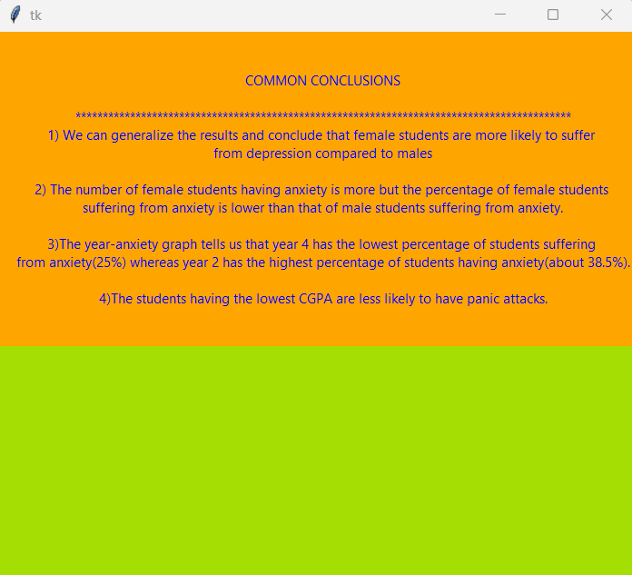
The values entered in each of the entry boxes must be of the same data type as indicated in the project code .
Click
Final Output
This screen shows the main inferences drawn from the graphical representations

Slide 10
Demo Video
For a live demo, check out :
https://www.youtube.com/watch?v=pMT2o6Ool5Q&t=9s

Slide 11
Toolkit Walkthrough
_https://docs.google.com/spreadsheets/d/1d1um7mGTnbywm4felQNp_2c0kqBFBpTH/edit?usp=share_link&ouid=108600098617961913745&rtpof=true&sd=true

Slide 12
Contact Person
In case of any clarifications or questions please feel free to reach out at below e-mail ID:
Name : Rohini Ghosh
E-Mail ID: RohiniGH2@gmail.com

Slide 13


